Slide 1

Zero waste
Schools Connect
Tackling climate change through student leadership

Slide 2
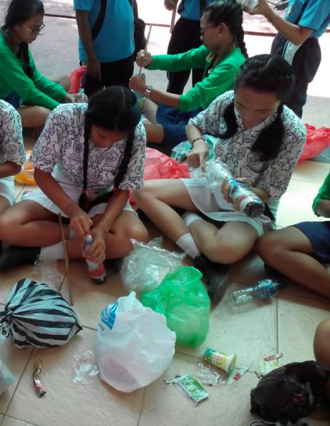
    These slides have been produced to support the Zero Waste learning unit. They can only be used with the main resource, which includes full instructions on how to use them with your class and a partner school.
Notes:
Main photo credit: Ecobricks
Source: http://www.ecobricks.org/bali-ecobricks/

Slide 3
Dramatic increase in population has led to greater production of food, transport and manufacturing, and therefore waste, both physical (such as plastic bottles) and carbon emissions (such as exhaust fumes) to the point where the average world citizen produces 4.2 tonnes of carbon per year; an average tree absorbs only 1 tonne of carbon per year

Slide 4
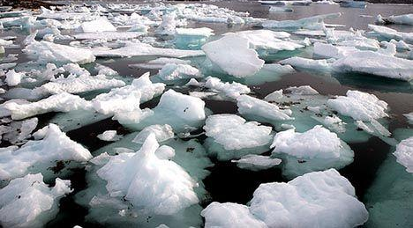
Ice caps and Artic ice are melting
Notes:
Photo credit: Nick Russill via flickr
https://www.treehugger.com/search?q=The+polar+ice+caps+
Notes: The polar ice caps are meting as the temperature of the Earthrises. This means that there is less ice for animals to live on, and the level of sea is rising. Rise in sea levels mean that delicate ecosystems, such as coral reek are affected, thus affecting marine life. We have also seen an increase in more storms and rain in some parts of the world, and drought in other areas the eco-system shifts.

Slide 5
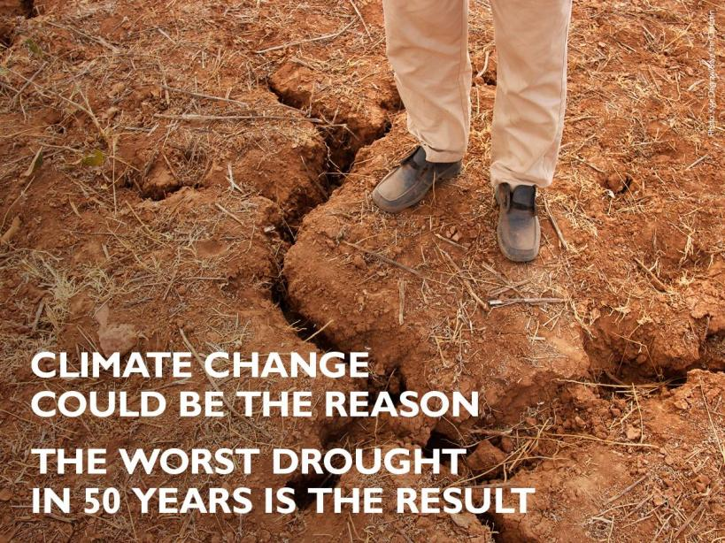
The worst drought in Ethiopia in 50 years
Notes:
Photo credit: Save the Children UK (December 2015)
Source: https://www.facebook.com/savethechildrenuk/photos/pb.117476785190.-2207520000.1450268370./10156308884055191/?type=3&theater
Notes: Ethiopia is facing the worst drought in 50 years. It has ruined harvests, devastated livestock and left families struggling to find food and water.
The Ethiopian government has launched a huge effort to tackle it - we’re doing all we can to help.
Together, we can stop the threat to children’s lives. Act now > http://save.tc/VC4OK

Slide 6
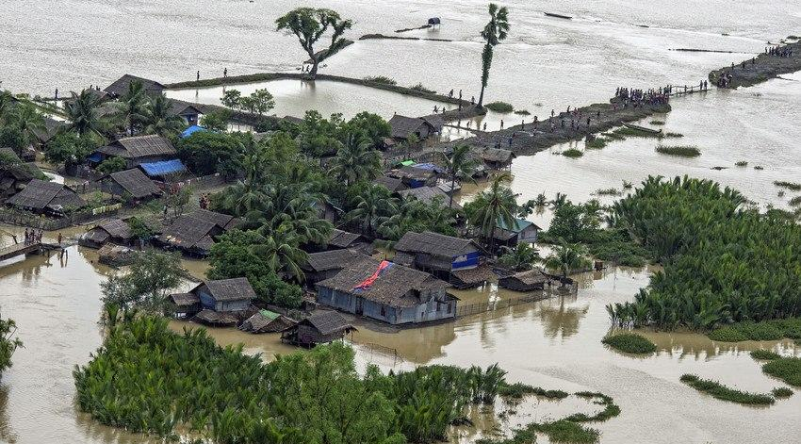
Floods in Myanmar
Notes:
Photo credit: Save the Children UK (August, 2015)
Source: https://www.facebook.com/savethechildrenuk/photos/pb.117476785190.-2207520000.1450268798./10155896450550191/?type=3&theater
Up to 80,000 children in flood-hit Myanmar are in need of essential hygiene and household items after floodwaters left entire communities underwater.
We’re giving out vital hygiene kits including soap and sanitary items to 150 families in Kayin State and working round the clock to assess the extent of the crisis and the needs of children and their families.

Slide 7
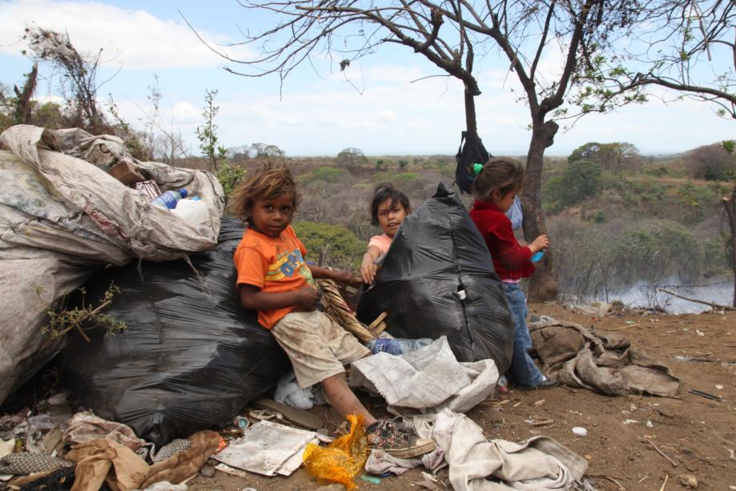
Children living and surviving on landfill sites
Notes:
Photo credit: Amy’s Blog
Source: https://smallstepsproject.wordpress.com/2011/05/07/shoe-distribution-project-la-joya-dump-granada-nicaragua/img_2150/
Notes: There are children who live all over the world in rubbish dumps, scavenging for waste that could be recycled and traded to get money for food. For many children, they are desperate to go to school, but because they cannot afford shoes for the long journey, they are unable to.

Slide 8
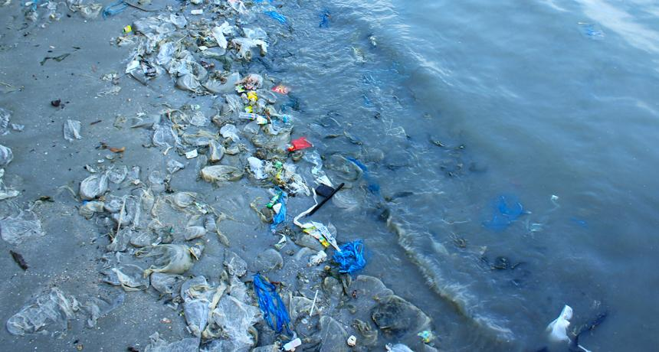
Plastic wash up on beaches and pollute seas
Notes:
Photo credit: RELAX_GAP/SHUTTERSTOCK, as cited in Science News (2014) ‘Plastic goes missing at sea’ (available online: https://www.sciencenews.org/article/plastic-goes-missing-sea)
Source: https://www.sciencenews.org/article/plastic-goes-missing-sea
Notes: Estimates put the amount of plastic entering the world’s oceans in the range of millions of tons. The plastic comes from a variety of sources, including trash floating down rivers or blown off garbage barges, fishing gear lost or abandoned at sea and tiny beads from cosmetics washed into sewers. When plastic reaches the ocean, the sun, waves and wind weaken large pieces, which break down into smaller chunks, Cózar says, until most plastic is in tiny fragments floating on the ocean surface.

Slide 9
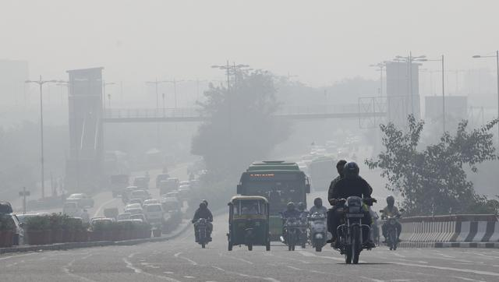
Air pollution in Dehli
Notes:
Photo credit: Sonu Mehta/HT Photo
Source: http://www.hindustantimes.com/delhi/delhi-pollution-plummets-on-dussehra-holiday/story-WYsmC9rouunHu6RiepYlBN.html
Notes: Dehli, India is one of the worst polluted cities in the world. The air pollution is so bad, that sometimes warnings are issue to residents, not to go outside. There are moves to try and reduce it, like car-free days, although these attempts are future a current rates of pollution at 16 times higher than safe air levels.

Slide 10
Learning outcomes
Student leadership: the process of which individuals empower others to make change, sometimes as role models, sometimes as catalysts for personal development in others.
Collaboration: work in teams to design a mini-project to support better waste management in the community

Slide 11
Zero waste – Data
Schools Connect

Slide 12
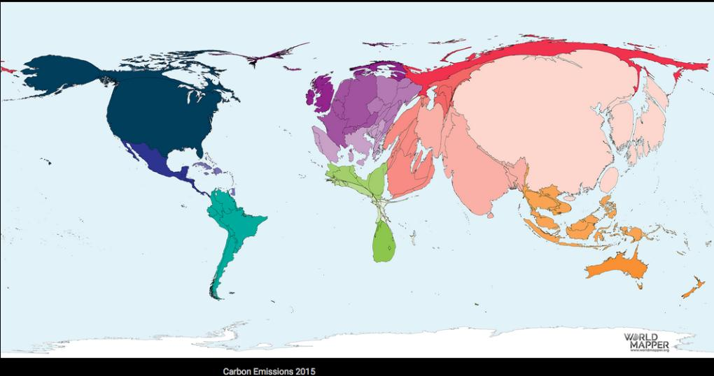
Notes:
Source: https://worldmapper.org/maps/?_sft_product_cat=resources&sf_paged=4
Carbon Emissions 2015

Slide 13
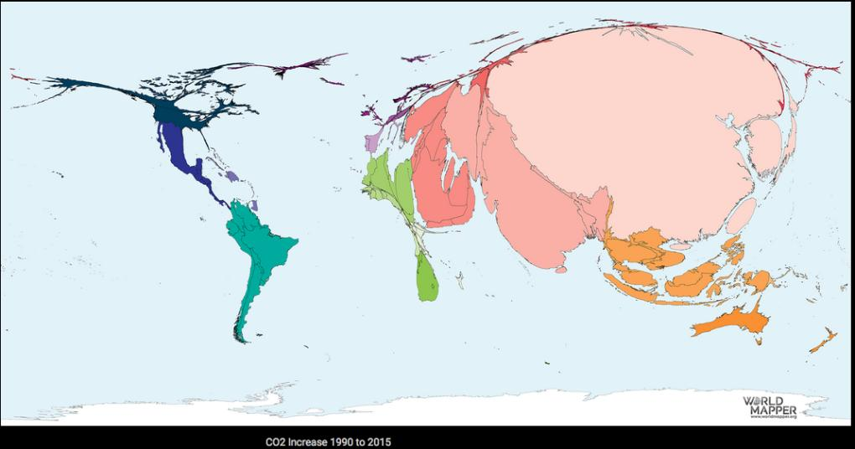
Notes:
Source: https://worldmapper.org/maps/?_sft_product_cat=resources&sf_paged=4
CO2 increase 1990 to 2015

Slide 14
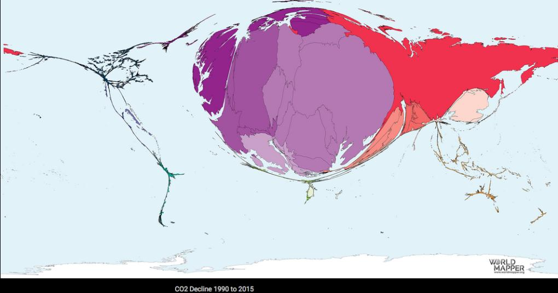
Notes:
Source: https://worldmapper.org/maps/?_sft_product_cat=resources&sf_paged=4
CO2 Decline 1990 to 2015

Slide 15
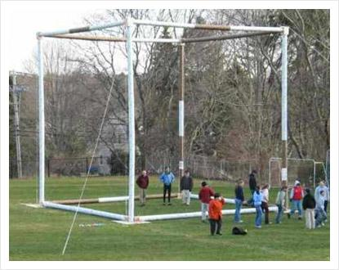
What does a tonne of carbon (gas) look like?
The average global citizen generates 4.5 tonnes per person per year.
A tree absorbs 1 tonne or carbon per year.
That means that there must be at least 4.5 trees per person on Earth in order to neutralise the carbon emissions.
World population currently stands at approximately 7 billion (7,000,000,000)
There are am estimated 3 trillion
(3,000,000,000,000) trees on the planet.
Notes:
Main photo credit: Dave Ames
Information source: http://www.treehugger.com/natural-sciences/how-many-trees-are-there-world.html
Notes:
4.5 x number of population (7,000,000,000) = 315,000,000,000
So, if we need only 315,000,000,000 and we have approximately 3, 000,000,000,000 trees we have enough? Problem is, we are ee are cutting down approximately 16 billion (16, 000,000,000) per year. In other words, everyone would need to plant an extra two trees per year in order to just mitigate the amount we are chopping down.
It is also important to note that it can take up to 30 years for a tree to reach full growth so that it can absorb 1 tonne per year.

Slide 16
Zero waste – Case
Studies
Schools Connect
Notes:
Main photo credit: Ecobricks
Source: http://www.ecobricks.org/bali-ecobricks/

Slide 17
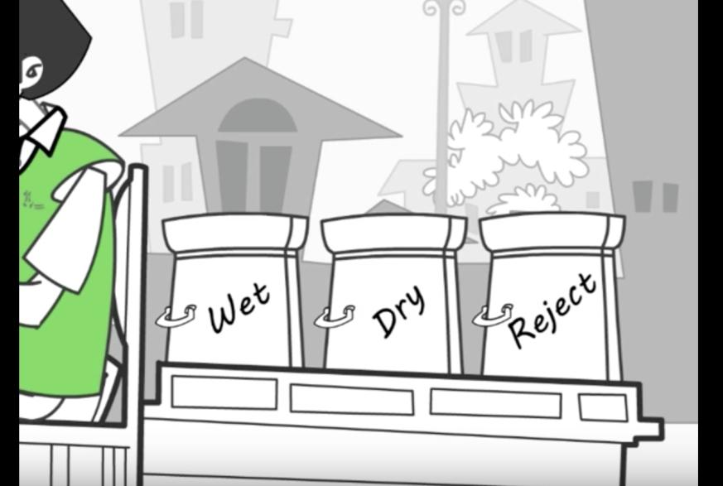
I got garbage
Notes:
Source: One I Got Garbage (YouTube)
https://www.youtube.com/watch?v=LsaGE1A5wl8
http://www.igotgarbage.com

Slide 18
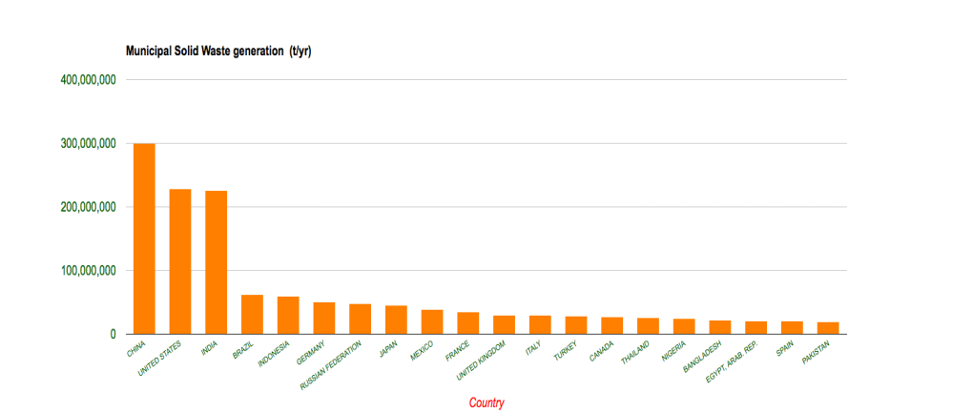
Recycling and waste data
Notes:
Source: Waste Atlas (http://www.atlas.d-waste.com)
Notes: The first chart shows the amount of waste generated by the top 20 countries in the world. What surprises you about this list? Can you locate them on a world map? Might the geography of the country have anything to do with waste disposal?

Slide 19
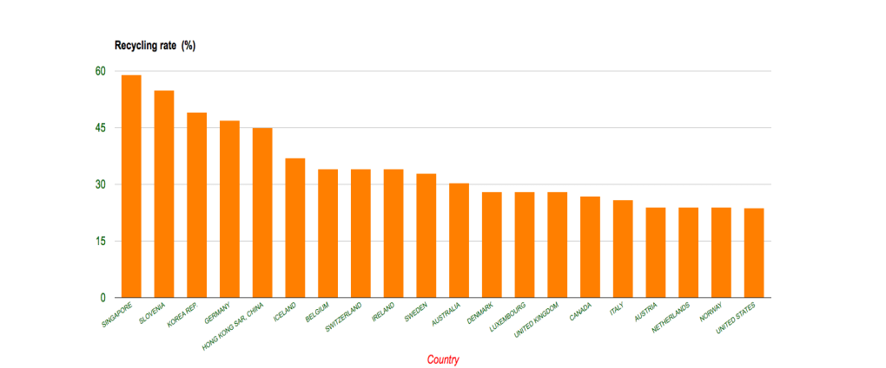
Recycling and waste data
Notes:
Source: Waste Atlas (http://www.atlas.d-waste.com)
Notes: The second chart, looks at the 20 countries which are better at recycling. Which countries appear on both charts? Are there countries which appear on the recycling chart but not on the waste chart?

Slide 20
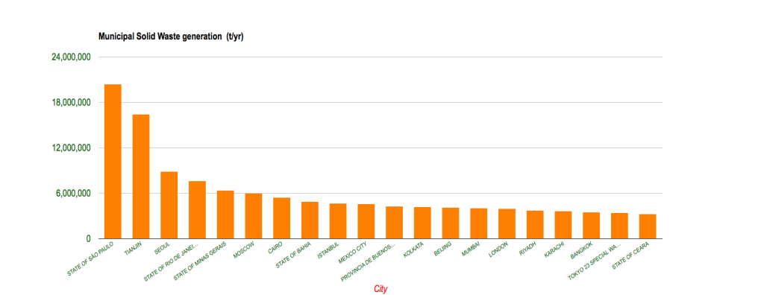
Recycling and waste data
Notes:
Source: Waste Atlas (http://www.atlas.d-waste.com)
Notes: The third looks at the top 20 cities in the world which have the highest level so waste generation. Are there any countries here which appear on both the country waste generation and recycling charts? Why might some cities be listed as the ‘worst offenders’ but the country it is in doe not appear on the country waste chart?

