Slide 2
Info Session UK Institutions EoI 30th September 2021

Slide 3
British Council Scholarship for Women in STEM
Women make up a fraction of the workforce and research teams in STEM,
Typical STEM worker now earns two-thirds more than non-STEM workers,
Sustainable Development Goal (SDG) Five – Gender Equality
The British Council has established programmes to support Women and Girls in STEM around the world, from inspiring young girls to stay in STEM to supporting women working in STEM fields reach positions of leadership and network with their peers in their region and the UK.

Slide 4
British Council Scholarships for Women in STEM 2020/21
Scholarship programme in partnership with 19 universities in the UK We received 35 applications from UK institutions
118 Scholarships in Total
15 East Asia
48 Americas
55 South East Asia
More than 4000 scholar applications in total
2981 Americas
1083 South Asia
269 East Asia
11 Women travelling with dependants

Slide 5
Master’s Degrees

Slide 6
Master’s Cohorts
East Asia
South Asia
Cambodia, Indonesia, Laos, Malaysia, Myanmar, Philippines, Thailand & Vietnam
Bangladesh, India, Nepal, Pakistan & Sri Lanka
FCDO ASEAN Dialogue
Cambodia, Laos & Myanmar
Brazil, Mexico & the Americas
Egypt
Argentina, Brazil, Colombia, Cuba, Jamaica, Mexico, Peru & Venezuela
Ukraine
Turkey

Slide 7
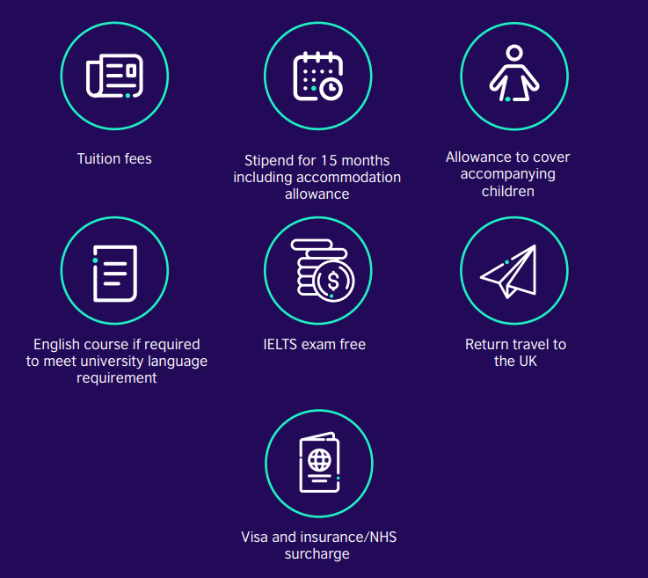
Master’s Cohort
£175,000 each cohort.
Average value of £35,000 each scholar.
At least 5 scholars for each cohort.
12

Slide 8
Early Academic Fellowship Grants

Slide 9
Early Academic Fellowship
£175,000 each cohort.
At least 4 scholars for each cohort.
Minimum £25,627 per annum salary plus relevant London weighting if applicable.
£10,000 for research related expenses.
South Asia & East Asia

Slide 10
How does the scholarship work

Slide 11
How does the scholarship work
If your institution is successful, we sign a Grant Agreement and we will transfer the total amount of the grant to the institution.
Institution Web page promoting scholarship.
British Council promote scholarship.
Candidates will apply to the institution and also apply to the scholarship through a specific form.
Institution will provide a shortlist of candidates to the British Council to be considered for the scholarship.
British Council will confirm the scholars to institutions.

Slide 12
How to apply?

Slide 13
Webpage
https://www.britishcouncil.org/education/he-science/opportunities/partnerships/women-stem-scholarships-call-uk-host-institutions

Slide 14
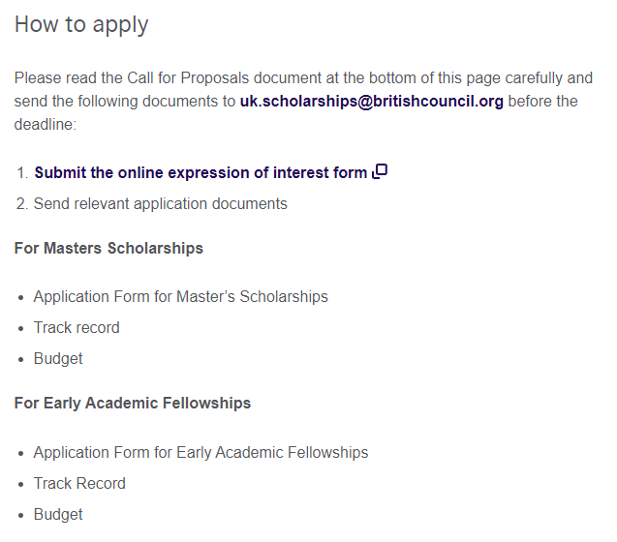
How to apply
Email
Online EoI Form
Three documents:
Applications Form
Track Record
Budget

Slide 15
Online EoI Form
Contact Information
Information for Grant Agreement
Application to cohorts
Supporting documentation
Declarations

Slide 16
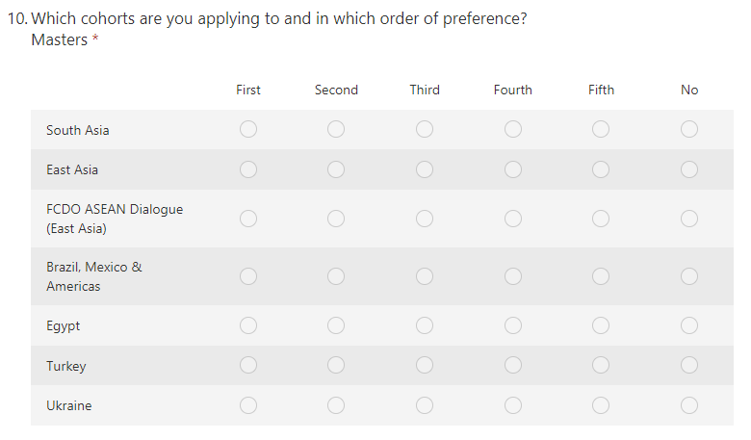
Application to cohorts

Slide 17
Supporting documentation

Slide 18
SD01a _ Application to scholarships
List of programmes
You can apply for up to 5 Master’s cohorts. Please list in order of preference.
You can propose the same programs to all cohorts.
No limit.
The Programme names, descriptions, and URLs you give here will be used in future marketing of the scheme, should you be successful, so please ensure details are correct.
Departments and brief description of research strengths. Important connections to countries applying to.

Slide 19
SD01b _ Application to Early Academic Fellowship
List of departments
You can apply to both cohorts.
Describe research strengths and connections to countries.
What we will need to know:

Slide 20
Your Offer
What welfare support will you provide scholars
Connections to industry, internships, placements, career development, etc.
Cash or In-kind contribution.
Other added value.

Slide 21
What are we looking for
UK universities and research institutions, with a commitment to Equality, Diversity and Inclusion (EDI
Programme areas:
Health and Life Sciences
Climate Change, Environment and Risk Reduction
Energy Transition
Agriculture
Industry 4.0 / Digital Transformation
Conversion masters from BA/MA in a range of disciplines
Programmes selected should meet the spirit of ODA, with the potential to focus on outcomes that promote the long-term sustainable growth of countries.

Slide 22
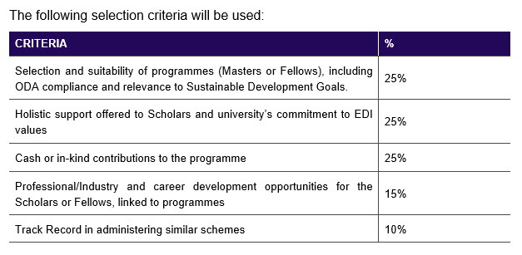
What are we looking for

Slide 23
Track Record
We are particularly interested in seeing your track record in administering means-tested bursaries and learning how you captured and made assessments on relevant data in a transparent way, without being overly intrusive.
Your Track Record can include scholarships/bursaries set up using only funding from your university, but we are interested in seeing examples of your experience in managing bursaries with 3rd party funding. Please include a minimum of three and maximum of five examples in your track record, from the last 10 years.
If your institution has experience holding early fellowship awards such as Knowledge Transfer Partnerships or a similar scheme, either internally or externally funded, please provide details here if you are applying for an Early Academic Fellowship cohort.
Description of project team managing the scholarship.

Slide 24
Budget
Two tabs – one for Masters / one for Academic Fellowship
Where is the institution based
Tuition fees.
Reserved funding to support dependants
Monthly stipend based on UKVI requirements
Reserved – might not be needed
Fellowship: information regarding duration

Slide 25
Thank you Please refer to the Q&A document to access additional enquiries you may have.

