Slide 1
Enhancing Employer Engagement in the Design & Development of Effective Skills Solutions
Amman
8-9 September 2015

Slide 2
Employability Skills
Richard Beamish
Notes:
Explain Employability Bites
Now looking at employability as a whole, is it important and who is responsible?

Slide 3
What are Employability Skills?
‘A set of attributes, skills and knowledge that all labour market participants should possess to ensure they have the capability of being effective in the workplace – to the benefit of themselves, their employer and the wider economy.’
CBI, 2010
Notes:
A couple of definitions

Slide 4
Employability skills
“Employability defines the knowledge, skills, attitudes and behaviours required by individuals to seek, obtain and sustain employment at all levels in the labour market.”
Skills for Business Network definition, 2007

Slide 5
“Employability skills are the skills that almost everyone needs to do almost any job”
Self-management
Thinking and solving problems
Working together and communicating
Understanding the business
Using numbers effectively
Using language effectively
Using IT effectively
Positive approach
UKCES: The Employability Challenge
Notes:
This is a bit less glorified and more practical
Hard and soft skills
5

Slide 6
What employers look for?
Can you do the job?
Are you motivated?
Do you fit with the organisation?
Notes:
What employers look for in a job candidate
Can you do the job?
Do you have the necessary abilities, skills, knowledge, experience and qualifications?
How soon can you become productive? Are you a fast learner?
Are you able to work unsupervised, use your initiative and work confidently under pressure?
Will your work be accurate and high-quality?
Are you organised and able to achieve goals?
Are you motivated?
Are you motivated, and do your goals benefit the company?
Will you work for the best interests of the organisation?
Are you dependable (i.e. reliable and trustworthy)?
Do you fit with the organisation?
Do you have a good attitude?
Does your presentation and appearance represent the company well?
Are you a team player? Do you get on well with others? (The employer wants someone who won't create problems among other workers.)
It is your responsibility to provide employers with the best information to help them make a quality hiring decision. If you consider all the needs listed above, you will increase your chances of getting a job offer.

Slide 7
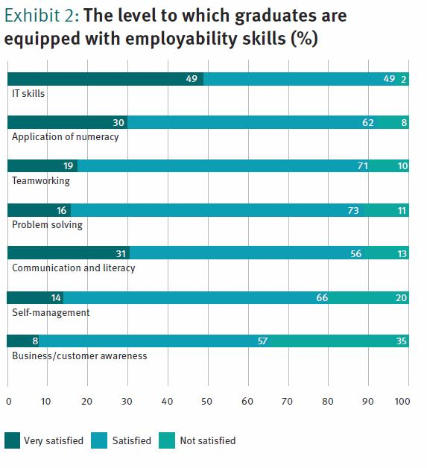
Often potential employees don’t have the skills employers need
…or is it that potential employees aren’t demonstrating that they have them?
Notes:
These slides show how too employees just do not have the skills employers need

Slide 8
A curriculum for employability
Learning in a work context
Business involvement
Synthesis of theory and practice
experiential learning
Experiences of work
high fidelity or high validity
Aiming for progression to work, HE/FE
Employability Bites?
Notes:
Obvious answer is to focus on employability in schools, colleges and universities.
Done some work with schools linked to journalism and print sectors.
Employability Bites are an example from someone involved in this work over many years but they assume employer involvement.

Slide 9
Benefits to employers
better prepared workforce
recruitment
staff development
business development
public relations
employee relations
force for change
interdependent community partnership
working with young people
individual creativity
parental aspect
Notes:
We’ve already seen the benefits to employers of having work-ready employees and recruits. The bigger question is who is responsible?

Slide 10
…but what about the existing workforce?
How do you improve:
Language skills?
Number?
Soft skills?
Whose responsibility is it to ensure employees have the skills they need?
Who should pay?
What are the alternatives?
Notes:
…and what do you do with existing employees?

Slide 11
Benefits of improving workforce skills
Increased productivity
DHL Aviation increased productivity by 12%
Reduced wastage
Co-op cleaning – boosted loyalty and raised standards
Cost savings
Fowler Welch Coolchain saved nearly £450,000 per year
Reduced accidents
Pirelli reduced minor accidents by 16%
First Bus saw 30% drop in staff injuries
Also absence management, recruitment & retention, increased staff morale and reputation management
Notes:
Well, larger companies do invest in workforce skills and this slides shows some who claim to have benefited.

Slide 12
Employability Toolkit
Produced by Building Futures Group for all UK Sector Skills Council employers
Tool 4: are a lack of employability skills causing problems in your organisation?
Tool 5 : Employability Matrix
Notes:
There are ways of identifying whether you have an employability issue and then deciding what to do about it.
The Employability Toolkit can help – see papers given out at start:
4 will help you decide if you have a problem
5 helps identify the skills needed and the level

Slide 13
Employability Matrix
Fundamental Skills:
Communication
Use numbers
Manage information
B: Personal Management Skills:
Demonstrate positive attitudes and behaviours
Be responsible
Be adaptable
Learn continuously
Work safely
C: Teamwork Skills:
The working environment
Work with others
Think and solve problems
Participate in projects and tasks
Notes:
The Employability Matrix is a core framework for the development of employability qualifications.
The Employability Matrix is a consistent and transparent framework for the approval of generic employability qualifications.
The Employability Matrix can be used as a “skills check” tool either by individuals or supported by tutors in a variety of situations such as entry to employment, redeployment or redundancy.
The Employability Matrix can be used to support a whole organisation approach to embed an understanding of employability skills across all activities and learning programmes.
The Employability Matrix is a flexible tool, which lends itself to adaptation to make it more “learner friendly”, i.e., a poster or single page to highlight key points
The Employability Matrix is regularly revised to reflect the needs of employers, which means its content is kept up to date.

Slide 14
Employability Toolkit
Produced by Building Futures Group for all UK Sector Skills Council employers
Tool 4: are Employability Skills a problems?
Tool 5: Employability Matrix
Tool 6: shows how to set the Matrix in a sector context (could be in a company)
Tool 7: recruitment and selection
Tool 8: Training Needs Analysis (TNA)
Tool 9: In-house Training
Notes:
6 is just an example of putting the Matrix into context
7 is designed to help with recruitment – helping ensure your new employees do have the skills they need
8 is a TNA designed to help identify the detailed employability issues within your own workforce
9 is just about the in-house training options, should you consider this a sensible approach

Slide 15
In-house Training
Informal
Job shadowing
Coaching
Mentoring
Cascading
Knowledge banks
Formal
Distance learning
Placement schemes
External courses

Slide 16
Employability Qualifications
Small bite-sized chunks of learning mean that learners can gain early accreditation, which encourages commitment to the learning programme (NOCN)
Strong potential for employability qualifications to be used by employers as a development tool for existing staff, particularly at Level 2 and Level 3.

Slide 17
Employer Involvement
McDonalds has chosen the Edexcel WorkSkills qualifications to underpin its work placement scheme. This was achieved by mapping its personalised work placement student workbooks to the Level 1 and 2 BTEC Certificate in WorkSkills.
Organisations using the qualification to support their activities, include: Coca-Cola, Compass, Tesco, HSBC, Nomura Bank, Solent EBP, Durham EBP and the Enterprise Forum.

Slide 18
Solutions?
Before Work:
?
?
?
At work:
?
?
?

Slide 19
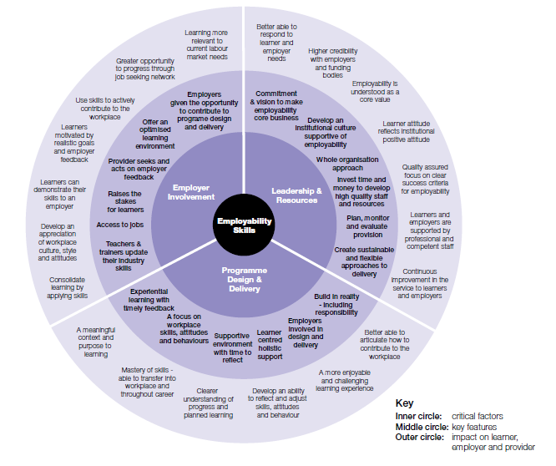
Employability wheel
UKCES the Employability Challenge Report 2009

