Slide 1

Quality Education for all children
Schools Connect
Improving schools through collaboration, communication, citizenship and leadership

Slide 2
These slides have been produced to support the Quality Education for all children learning unit. They can only be used with the main resource, which includes full instructions on how to use them with your class and a partner school.
Feelings
What are my feelings
right now?
Feelings can change.
No reasons need to be given.
Intuition, hunches, gut instinct.

Slide 3
Lesson one
Why can’t some children go to school?

Slide 4
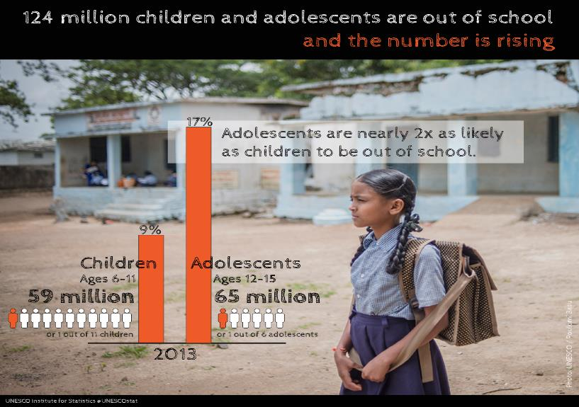
Out-of-school children
www.britishcouncil.org
3
Notes:
Credit: All in School: The Global Initiative on Out-of-School Children
Source: http://allinschool.org/wp-content/uploads/2015/04/OutofSchoolChild-English-lg.png

Slide 5
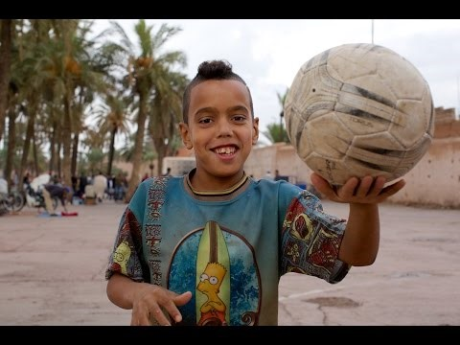
Out-of-school children
Feelings
What are my feelings
right now?
Feelings can change.
No reasons need to be given.
Intuition, hunches, gut instinct.
https://www.youtube.com/watch?v=ZceIZk1tKxs
www.britishcouncil.org
www.britishcouncil.org
4
4
Notes:
Video credit: UNICEF: You Know Me - who is not in school and why in MENA
Source: https://www.youtube.com/watch?v=ZceIZk1tKxs

Slide 6
Out-of-school children
Feedback sheet
Why can’t some children go to school?
Name: …………………………………………………………………………
What was the most interesting thing you learned in this class?
What else would you like to know about children who can’t go to school?
Did you enjoy this lesson? (Circle one answer)
Very much ……………..…. a bit ……………..… not really …………………… not at all
Why? Why not?
5
Notes:
Video credit: UNICEF: You Know Me - who is not in school and why in MENA
Source: https://www.youtube.com/watch?v=ZceIZk1tKxs

Slide 7
Lesson two
Quality education

Slide 8

Global Goals for Sustainable Development
http://www.globalgoals.org/#the-goals
Notes:
Credit: United Nations
Source: http://www.globalgoals.org/#the-goals

Slide 9
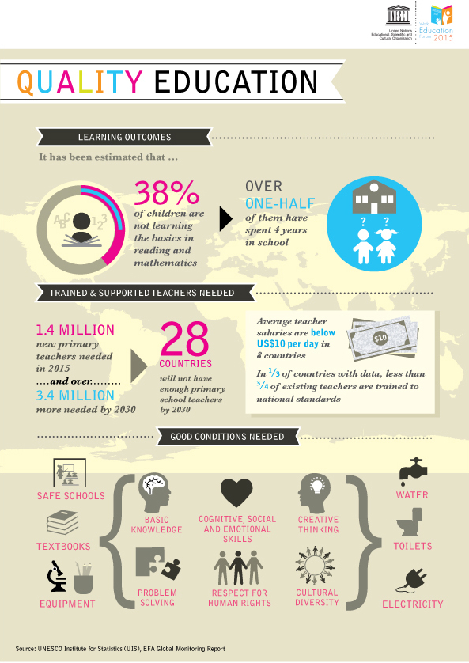
Notes:
Credit: UNESCO/World Education Forum
Source: http://en.unesco.org/world-education-forum-2015/5-key-themes/quality-education

Slide 10
Lesson three
How can schools make sure that all children feel they belong and are being treated fairly?
http://www.globalgoals.org/#the-goals
Notes:
Credit: United Nations
Source: http://www.globalgoals.org/global-goals/quality-education/

Slide 11
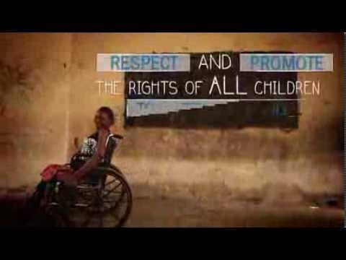
Listen Up! Children with disabilities speak out
https://www.youtube.com/watch?v=FjhF-pdlJ8M
Notes:
Credit: Plan International
Source: https://www.youtube.com/watch?v=FjhF-pdlJ8M

Slide 12
Our school as an inclusive and equitable
environment
Example interview questions
In our school, do you think everyone feels as though they belong and are valued?
Can you tell us about some of the good things that make people feel that they belong and are valued?
What do you think we can do to make the school more inclusive (make people feel even more that they belong and are valued)?
Do you think everyone is treated fairly in our school?
Why or why not?
What can we do to make sure that everyone is treated fairly in our school?
(Our question)
(Our question)

Slide 13
Lesson four
Our inclusive and equitable school

Slide 14
Lesson five
Sharing learning on inclusive and equitable schools

Slide 15
Resource Sheet 3
      Ask your partner the following questions, and write a summary of their answers on the sheet.
      Your name: …………………………………………………………………….
      Partner’s name: ……………………………………………………………….
      What was the most interesting thing you learned about inclusive and equitable quality education in the world?
      What skills do you think you learned and practised in the classes on education in the world?
      Which class did you enjoy most, and why?
      Was there anything you didn’t really understand?
      The last question is for you to discuss with your partner, and then write your joint answer on one of your sheets of paper.
      What other opinions do you have about this unit on education?

Slide 16
Lesson six
Why is education important?

Slide 17
Resource Sheet 4: Malala’s Life
Malala Yousafzai was born in the Swat Valley, in Pakistan. Many children in Pakistan cannot go to school, especially if they are girls, but Malala’s father thought that education was very important, and he ran a school.
When Malala was about 12 years old, the Taliban took control of the Swat valley. They did not want girls to go to school, and they closed many schools. Malala started writing a blog for the BBC, but she did not use her real name. She wrote about life in her town, and she said that she was afraid her school would be shut down.
The Taliban told Malala’s father that he had to close his school. Malala and her father continued to speak out for the right to education, even though it was very dangerous to do this. The Taliban told them to stop, otherwise they might kill them, but Malala and her father did not stop.
In 2011, Malala received the National Youth Peace Prize in Pakistan. She was becoming famous, and the Taliban decided to try to kill her, even though she was still a child.
On October 9, 2012, Malala and her friends were on the school bus on their way home from school. A gunman came on to the bus and asked which girl was Malala. Then he shot her in the head. Two of her friends were also injured.

Slide 18
Malala’s life (continued)
Malala survived but she was very badly hurt. She went to hospital in Pakistan, and then she was flown to a hospital in the UK. She had to stay in hospital for over two months.
People all around the world were very shocked that the Taliban tried to kill a 15-year old girl, just because she spoke out for education. Many people supported Malala and thought she was very brave, and she became a symbol of children’s right to education.
After she left hospital, Malala started going to school in the UK, but she was also even more determined to fight for children’s rights to go to school. She was now famous, and on her 16th birthday, she made a speech to the United Nations Youth Assembly.
In December 2014, Malala was the youngest person ever to receive the Nobel Peace Prize, for her work ‘for the right of all children to education’. She used her prize money to build a secondary school for girls in Pakistan, and continued campaigning for education for all children. She celebrated her 18th birthday by opening a school for Syrian girls in a refugee camp in Lebanon.
(Adapted from the Malala Fund website: https://www.malala.org/malalas-story)

Slide 19
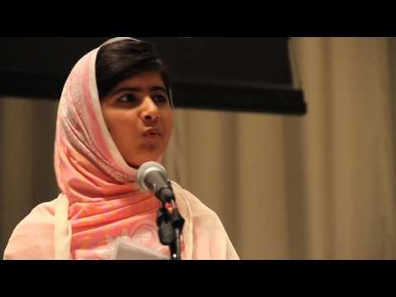
Malala at the United Nations Youth Assembly
https://www.youtube.com/watch?v=k_sIP08PZ6I
Notes:
Credit: United Nations
Source: https://www.youtube.com/watch?v=k_sIP08PZ6I
At UN, Malala Yousafzai rallies youth to stand up for universal education.

Slide 20
Powerful weapons
Let us pick up our books and our pens. They are our most powerful weapons. One child, one teacher, one book and one pen can change the world. Education is the only solution.
Malala Yousafzai
Notes:
YouTube. (2016). At UN, Malala Yousafzai rallies youth to stand up for universal education. [online] Available at: https://www.youtube.com/watch?v=k_sIP08PZ6I [Accessed 8 Apr. 2016].

Slide 21
Lesson seven
Syrian refugees –
what kind of education do children have?

Slide 22
Resource Sheet 5: Going to school in Syria
My name is Samer and I am 15 years old. I come from Aleppo, in the north of Syria. Aleppo is a very old, beautiful city. I grew up there with my mother and father and two older sisters and my younger brother, who is 11 years old. When I was six years old, I started primary school. I loved school, especially maths and Arabic. I used to walk to school with my older sisters and our neighbours. I had lots of friends at school, and after school we played football together. Sometimes, my mother would tell me I could not go out to play because I had not done my homework, but I always managed to get good grades at school anyway! My teachers were sometimes strict, but usually they were kind. At that time, I was very free, and very happy.

Slide 23
Everything changed when I was about nine years old. At first, lots of people were protesting in the streets, but I did not really understand why. Then after a while, the fighting started. It was when my little brother was starting school. Before that, we felt safe, but then people were being killed, and there were bombs. We didn’t really know why this was happening, but it was scary, because our homes and school were not safe any more.
One of my friends didn’t come to school one day, and the teacher said he had been killed. Then a bomb hit the road just next to our school. After that, my parents said we could not go to school, because it was too dangerous. We stayed at home, and I sometimes taught my little brother reading and writing, because he still didn’t know how to read and write properly. At first, it was OK, but later it was boring. Sometimes I sneaked out to play with my friends because I was so bored at home all the time, but my friends were leaving one by one, mostly to Turkey. In the end, there was almost nobody left. It was very lonely, and I missed school. At night, I was scared. My mother was scared, too, and she wanted to take us to a safe place, but my father is a doctor. He said he had to stay to look after all the people who were injured, and my mother did not want to leave without him. But then his hospital was hit by a bomb and many people died and his legs were injured. He couldn’t work any more. Then we left and went to Turkey.

Slide 24
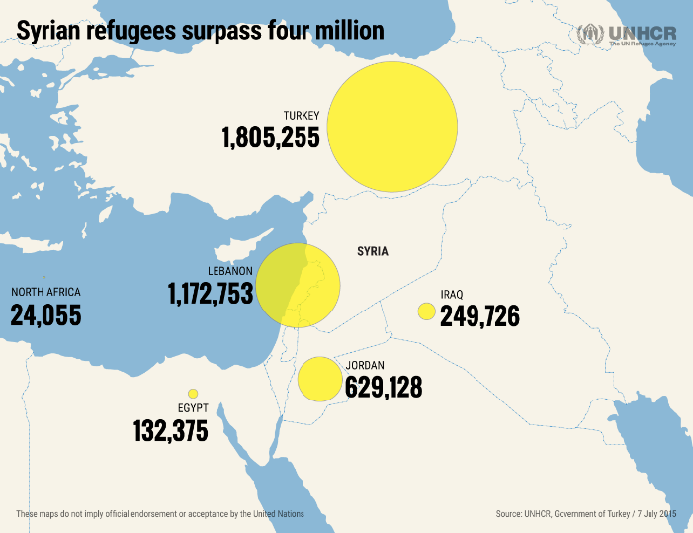
Where do Syrian refugees go?
http://unhcr.org/4million/
Notes:
Credit: UNHCR
Source: http://unhcr.org/4million/

Slide 25
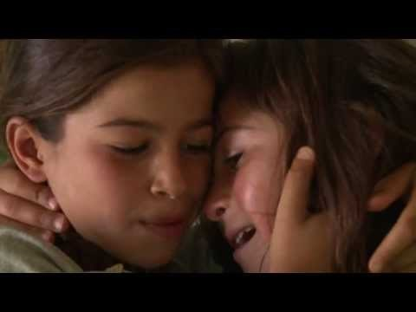
A Syrian refugee child in Lebanon
https://www.youtube.com/watch?v=xpG3jLGGkvc
Notes:
Credit: UNICEF
Source: https://www.youtube.com/watch?v=xpG3jLGGkvc
Aya is 8 years old.

Slide 26

Syrian refugee children in Iraqi Kurdistan
https://www.youtube.com/watch?v=KZovau4G3FY
Notes:
Credit: Save the Children
Source: https://www.youtube.com/watch?v=KZovau4G3FY
Save the Children has recently established a school for the Syrian refugee community in War City in the Kurdistan Regional Governorate of Iraq where there is a high number of Syrian refugees. The school is currently teaching 514 children.

Slide 27
Lesson eight
What can we do to improve the situation?

Slide 28
Resource Sheet 6:
Planning our action project
Project title: Team members: Project aim:
What do we need to do? | By when? | Who will do it? | Done?

Slide 29
Lesson nine
Take action!

Slide 30
Lesson ten
What did we do, how well did we do it, and what have we learned?

Slide 31
Resource Sheet 7: Evaluation of the action project
Project title:
Team members:
Project aim:
1. What did we do? (brief summary)
2. Did we achieve our aim? What is the evidence?
3. What went well?
4. How would we do things differently in the next project?

Slide 32
