Slide 1
UK Commission for Employment & Skills
Katherine Chapman – Assistant Director
UK Commission for Employment and Skills
Notes:
Welcome and introductions.

Slide 2
Contents
About UKCES
Research & Intelligence
Investing in Standards & Innovation
Commissioner Insights
From employer engagement to employer leadership
Achieving growth through people

Slide 3
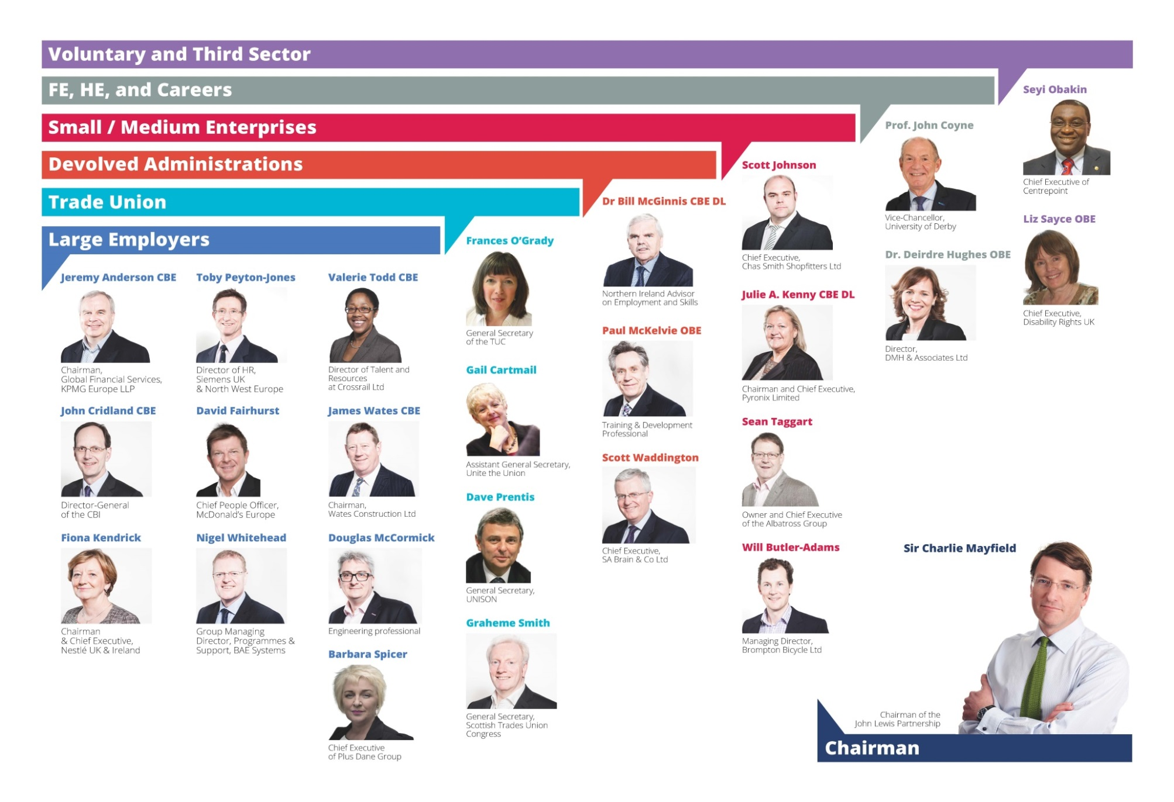
UKCES
Notes:
The UK Commission for Employment and Skills (UKCES) works with industry and government to help achieve better outcomes in how people get in and on in work and how businesses succeed through the skills and talents of their people. Our ambition is for a sustained recovery for the long term driven by the skills and talents of people – growth through people.
UKCES is a social partnership led by 26 Commissioners who are senior leaders of large and small enterprises, (including non-profits), further and higher education institutions from across the UK. Our Chairman is Sir Charlie Mayfield, Chairman of the John Lewis Partnership. We believe that it is the talents and skills of people drive business competitiveness and economic growth.
Our unique contribution and ability to create impact comes through the insights of Commissioners, our authoritative research and our approach of working with key industry sectors and wider networks of business leadership to galvanise action.
The UK Commission for Employment and Skills supports growth by encouraging businesses to invest in the skills of their people. We do this by providing access to investment, world-class research and expert insight.
UKCES is funded by government as a UK non-departmental public body and Commissioners are appointed by government ministers.

Slide 4
About the UK Commission for Employment
and Skills
Commissioner
Insights
Investing in Standards and Innovation
Research and
Intelligence
IMPACT
Our ambition is to transform the United Kingdom’s approach to investing in the skills of people as an intrinsic part of securing growth
Notes:
UKCES is a publicly funded, industry-led organisation providing strategic leadership on skills and employment issues in the four home nations of the UK. Our mission is to work with and through our partners to secure a greater commitment to invest in the skills of people to drive enterprise, jobs and growth.
Impact: All of our work is driven by the need to achieve impact and secure the following four outcomes:
More employers investing in the skills of their people
More career opportunities for young people
More collective action by employers through stronger sectors and local networks
More employers stepping up and taking ownership of skills.
Through the insights of our Commissioners, our research, our investment in innovation (through the Futures Programme) and our coordination of NOS across the UK – used to underpin Apprenticeships and vocational qualifications, we face both ‘into’ Government, and ‘out’ to employers, their representatives and key stakeholders.
>>NEXT SLIDE – LMI Products

Slide 5
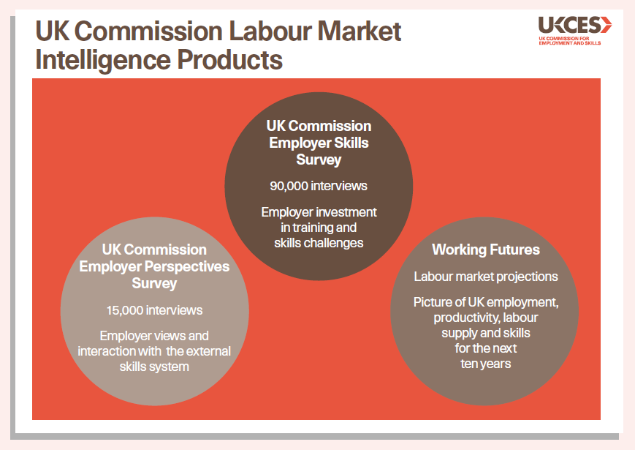
Our Intelligence
LMI For All
Notes:
What we do – Research & Intelligence
We provide outstanding labour market intelligence that helps businesses and people make the right choices for them.
Contributes to Policy Advice; National Occupational Standards; Apprenticeship frameworks; Investment decisions
Robust basis to question employer ambition
Resource for training providers to understand the market alongside their own local intelligence
We publish major UK-wide employer surveys and detailed projections of employment and skills. We also provide data and analysis at local levels and by occupation.
Together these outputs provide a vital foundation to inform our understanding of the UK economy as a whole and provide common and consistent intelligence which can be analysed in more detail (e.g. by different sectors, occupations, geographies) to pull out different trends and to allow comparisons to be made.
All our work can be found on the UKCES website, and can also be provided by emailing us directly. Details will be provided at the end of this presentation.
EPS
The Employer Perspectives Survey looks at employer’s perceptions and use of external skills initiatives and services, including for example apprenticeships and vocational qualifications as well as different recruitment channels. It’s published every two years, alternating with the Employer Skills Survey. The next one is planned for the end of 2014-start of 2015.
ESS
The UK Commission’s Employer Skills Survey is a UK-wide employer skills survey and one of the largest telephone employer skills surveys in the world, surveying over 90,000 employers. It’s produced every two years, with the latest survey results published at the end of January 2014. The survey builds on a long history in the countries around the UK though, so for example in England we have robust time series going back a decade.
Working Futures
Working Futures is a set of labour market projections that help us understand labour market prospects for next ten years. It can be used for example to: input to careers and skills advice, inform policymakers at national & local levels, and, inform curriculum strategies. The latest update, giving projections for the years 2012-2022 is being published next week, 3rd March 2014.
Making the data accessible for all – LMI for ALL pilot
The UK Commission has recently made progress in developing a pilot initiative that is expected to have a major impact on the way that LMI is used for careers information and advice purposes, including in a college setting.
LMI for All is a data portal designed to improve the accessibility of national sources of LMI, with the primary aim of informing individual careers decisions.
It brings together, collates and organises the key datasets that have previously been under-utilised in this field due to a lack of awareness and lack of technical knowledge among potential users.
It seeks to answer the questions people want answers to when thinking about careers and learning such as: where are the vacancies?; how much would I get paid?; what hours will I work?; where are the jobs located?; what skills do I need?; what jobs would suit my interests?
Some data on skills shortage vacancies has been incorporated into the tool, drawing on the UKCES’ Employer Skills Survey. We are seeking to incorporate wider vacancy data from the Universal Jobs Match and are currently in discussions with Monster about this.
>>NEXT SLIDE – Let’s look more closely at EPS, our latest survey to be produced

Slide 6
Notes:
Our large-scale employer surveys provide robust intelligence to help us understand how employers fulfil their skills needs, including their recruitment and training decisions.
The latest Employer Perspective Survey of 18,000 businesses was published on 13th November. I’ll be using this today to look at what employers are looking for in terms of employability of new recruits, and when training and up-skilling their staff.
EPS is produced every two years, and provides a representative, UK-wide picture of vacancies, recruitment activity, work experience placements and internships, apprenticeships, training activity and use of National Occupational Standards and Vocational Qualifications. Over 18,000 employers were interviewed between July and August 2014, and they were representative of all UK workplaces of more than two employees, making it possible to analyse the results by size, sector, region and LEP area. The survey is an establishment based survey, meaning we interview at the workplace, branch or site level rather than headquarters. This is to ensure that we get an accurate picture of what is actually happening on the ground.
We have a Report and data tables available on the gov.uk website focusing on the UK findings, and how they breakdown by sector, nation and size of employer. We’ll also be releasing much more local information in the New Year including comprehensive LEP tables and regional slide packs.

Slide 7
Investing in Innovation - UKCES Futures Programme
A programme of competitions that target specific workforce development problems
Competitions so far:
Skills problems in the off-site construction industry
Increasing demand for management and leadership skills
Stimulating progression and pathways in the retail and hospitality sectors
Notes:
This is essentially an R&D programme. Very small investments to test and apply skills solutions. Not paying for training

Slide 8
Investing in National Occupational Standards
Standards
- Advice to Governments on which standards will achieve the best outcomes and impact
- Securing standards, on behalf of employers and four nations, to underpin apprenticeships and vocational qualifications
- Managing the quality assurance and approval of standards
- Reporting on the impact of standards across four nations
LMI/Evidence Base
- UKCES Research portfolio
- Triangulation of evidence from other sources
- International benchmarking and comparisons including links to European standards and qualification frameworks
- Evaluation – outcomes and impact
UKCES Role
Notes:
What are NOS ? A National Occupational Standard is a statement that describes what an individual needs to do, know, and understand in order to carry out a particular job or function to an acceptable standard. In other words it pulls together all of the aspects of occupational competence
NOS are not:
courses
training programmes or
qualifications
The following are examples of NOS uses from recent NOS Evaluation Framework Paper (Jan 11)
Measuring staff competence
Development of competence frameworks
Reviewing working practices and/or service delivery
Reviewing and revising roles
Encouraging good practice
Supporting staff supervision processes

Slide 9
From employer engagement to employer ownership:
Employer Investment Fund: A competitive fund to develop skills solutions, create capacity & develop the underpinning skills infrastructure in sectors & localities.
* Sector Skills Councils only
* UK Wide
Growth & Innovation Fund:
A competitive fund to develop skills solutions, create capacity & develop the underpinning skills infrastructure in sectors & localities
* Any employer-led body
* England only
Employer Ownership of Skills Pilots:
A competitive fund of £340m over 4 years. Employers can develop proposals to create jobs, raise skills, drive enterprise & economic growth in England and look for joint investment from government to meet the costs
* Employer-led
* England only
Notes:
Overview of UKCES investment journey:
In February 2011, UKCES was set a new remit to work with Government to raise skill levels to help drive enterprise, economic growth and create more and better jobs. Over the last 3 years, the Commission has responded to this revised remit by moving from a ‘grant funding’ model for Sector Skills Councils to a competitive investment approach available to a wider number of employer organisations and by developing and latterly, supporting the delivery of the Employer Ownership Pilots.
One of the ways we have met this remit is by encouraging greater employer ownership of skills through our co-investment capability; the Department for Business, Innovation and Skills allocates public money to UKCES so that we can co-invest alongside employers (and other organisations) in projects that address market failures which are currently acting as barriers to business performance, and also to create interventions that raise productivity and support economic growth.
The impact of UKCES investment activity:
We have developed a balanced portfolio across scales of project, types of project and closeness to market, and have an expanding range of delivery partners. There are some very innovative and exciting projects across the portfolio. We are certainly seeing a major shift in the way we and SSCs are working better with industries and employers, there is better alignment between investment in skills and wider growth strategies, and there is clear progress towards greater employer leadership.
The different types of project we have co-invested in to date include:
Establishing employer networks (both spatial and sectoral)
Helping businesses to measure their investments in human capital development
Creating training levies
Creation of bespoke apprenticeship, work experience and traineeship programmes

Slide 10
Industrial Partnerships
Coalitions of leading employers in key industry sectors aligned to the Industrial Strategy
8 Partnerships: Automotive; Aerospace; Energy & Efficiency; Technology; Nuclear; Tunnelling; Science & Creative Industries
Government co-investing £131m with employers
Businesses working with each other and with trade unions, sector skills councils and other sector bodies, and other education and training providers to tackle the skills and recruitment challenges in their industries.
Notes:
Creative industries IP – led by Channel 4, includes the BBC: £20m govt investment alongside £17m employer investment
EEIP led by National Grid, employers in the power and utilities sectors are working together for the first time and with their supply chains to tackle issues of energy demand and job creation. Looking in particular at youth employment; first line supervisor training; skills leverage through procurement and export strategy
Most IPs also at the forefront of the govt’s apprenticeship reforms.

Slide 11
Notes:
INSIGHTS – culmination of our research and intelligence plus our thinking
Despite recent strong growth, the effects of the recession are still being felt on the UK labour market and economy: since 2010 real wages have fallen by around two per cent each year; and GDP per hour worked is 30 per cent higher in the US and France than in the UK. There remain deep-seated challenges formed over the last 30 years that must be addressed if growth is to be sustained and competitiveness improved.
As the economy continues to strengthen now is the time to take action to tackle the deep-rooted skills mismatches in the labour market. Five per cent of the workforce are not fully competent at their job, yet 16 per cent (4.3 million workers) have skills and qualifications that are not being used at work. They could fill Wembley Stadium more than 47 times.
Earlier this year we set out an analysis of the deep-rooted skills and employment challenges using the metaphor of rungs on the career ‘ladder’:
UKCES (2014) Climbing the Ladder: Skills for Sustainable Recovery.
Getting in:
Youth unemployment is falling significantly; in the last year it has dropped by over a quarter. But in the UK the ratio of youth unemployment to adult unemployment is significantly higher than in other leading economies, caused by long-term structural problems with the UK labour market. We must address the lack of opportunities for young people to get into work and the number of working people unable to progress in their career.
Getting on:
Technology, globalisation and longer working lives are changing career paths. Businesses need to develop new middle skill career pathways as old ones decline. Ensuring that there are opportunities for everyone to progress by raising their skills and finding a better job is critical.
Moving up:
Persistent skills shortages for high skilled workers, combined with poor use of the skills we already have, are hampering competitiveness. In terms of training, just one fifth of managers in the UK hold a management-related qualification and only 50 per cent of managers receive training – the lowest of any type of worker. We need excellent management to help us increase competitiveness by making the most of our existing skills, and increasing the number of high-skilled jobs.

Slide 12
Growth through people – five priorities
Employers should lead on skills and government should enable them
Workplace productivity should be recognised as the key route to increasing pay and prosperity
‘Earning and learning’ should be the gold standard in vocational education
Education and employers should be better connected to prepare people for work
Success should be measured by a wider set of outcomes, not just educational attainment
Notes:
This week UKCES published the ‘Growth Through People’ statement - an opinion piece on how we think the skills and employment system needs to change to tackle the challenges in the UK labour market around jobs, skills and productivity, backed up by a substantial evidence base.
Fronted by Sir Charlie Mayfield, John Cridland of the CBI and Frances O’Grady of the TUC, the aim of the statement is to influence government policy and wider policy thinking ahead of the general election and provide a strong platform for action over the longer term. We have built backing for our proposals among the education, policy and business communities and it has been well received and supported – we clearly all have an aligned vision for tackling the UK’s skills issues. Skills are integral to employment prospects, pay and wellbeing, business competitiveness and the economy. The value of employed human capital has been estimated at £17.61 trillion – two and a half times the value of ‘hard’ assets such as buildings, vehicles and machinery.
ONS (2014) Human Capital Estimates, 2013.
Five priorities for action are identified: collective action by employers, focusing on productivity in the workplace, more ‘earning and learning’ opportunities, education and employers working better together and measuring success in the skills system by a wider set of outcomes than just qualifications.
1 - Employers should lead on skills and government should enable them
We need a new level of leadership from employers to take responsibility for competitiveness and growth.
Employers, working with each other and with their employees and trade unions, should raise the bar on skills in sectors, regions and supply chains. Collaboration is vital to building the skills we need for competitiveness.
Governments should commit to supporting employer leadership on skills, individually and in partnerships, as a central part of long-term growth plans and a way of aligning public and private resources.
2 - Improving workplace productivity should be recognised as the key route to increasing pay and prosperity
Up to 90% of the current workforce will still be in work in the next decade. To tackle the productivity deficit for the economy as a whole, there must be a much greater focus on job design, technology and progression for those in work.
Equipping people with the right skills and giving them the best opportunities to use them will lead to better paid jobs.
This means better leadership and management of people and organisations, increased employee engagement and more transparency about the value of people to business success.
3 - ‘Earning and learning’ should be the gold standard in vocational education
We need a step change in attitude and uptake of quality vocational routes into good jobs. High quality apprenticeships should be a normal career pathway for many more young people, and a normal way for businesses to recruit and develop their talent pipeline.
Employers, working collaboratively, should have the lead role in designing apprenticeships to ensure they have value in the labour market. The public contribution should be channelled via employers to stimulate greater employer uptake.
In England, long-term stability in vocational education and training is essential for employers to have the confidence to engage.
4 - Education and employers should be better connected to prepare people for work
To create new pathways into work we need to start much earlier. All schools should have links with local businesses and use those links to inform and inspire young people about the breadth of career opportunities available.
Further education colleges should be supported to work with employers to deliver higher level technical and professional education to meet the UK’s technical skills gaps.
Closer collaboration between employers, colleges and universities is essential to ensure there are seamless opportunities to work and learn over the course of longer working careers.
5 - Success should be measured by a wider set of outcomes not just educational attainment
We need to align measurement of schools, colleges and universities more clearly with the outcomes that are needed for sustained growth through people.
These outcome measures should be more prominent in demonstrating accountability and key outcome data shared widely with employers, individuals and communities.
Reliable labour market intelligence should be widely used to support better decision making by individuals, employers and education providers.

Slide 13
Thank you
www.gov.uk/ukces
Moira.mckerracher@ukces.org.uk
@UKCES

