Slide 1



GESI & the UK TVET sector
- challenges and solutions
©️Evolve Global Solutions Ltd

Slide 2
Afshan Baksh
– Skills Specialist & founder of Evolve Global Solutions
Delighted to share my thoughts with you today.
©️Evolve Global Solutions Ltd

Slide 3
UK TVET – Learner Demographics
Learners 14 years old to 80+ years old
Life-long learning
77% while, 9.6% S Asian, 6.8% Black, 3.4% mixed, 2.8% other
Females account for 60% of 19+ learners
Learners with learning difficulties/disability account for 18%, an increase of 10.6%
©️Evolve Global Solutions Ltd
Notes:
https://www.ethnicity-facts-figures.service.gov.uk/education-skills-and-training/a-levels-apprenticeships-further-education/further-education-participation/latest

Slide 4
UK TVET (Further Education) sector is multi-layered
TVET colleges, private training providers, community, prisons
and in the work-place
Pre-entry (entry 1, 2, 3) then Level 1 to Level 7 qualifications
L3 = High School graduation exams (O-Levels)
L6 = degree level
L7 = Masters
©️Evolve Global Solutions Ltd

Slide 5
Learner Progression
Vocational Learners
Higher Level Vocational Programmes
Employment
Apprenticeship Programmes
Higher Education
©️Evolve Global Solutions Ltd
Notes:
Our vocational learners have a number of progression routes available to them

Slide 6
UK TVET Staff Demographics
61% female
85% white British (white other, South Asian, Black, Mixed, Chinese, other)
Gender pay gap – approx. 10% (pay for female staff has increased by 6.9% overall)
High numbers of female staff in admin, support, catering
A slightly higher number of male staff in senior leadership roles and teaching roles
An almost 50/50 split of female to male in middle manager roles
Gender pay gap – 10% in FE
©️Evolve Global Solutions Ltd

Slide 7

Challenges & Solutions
Case Study: West Lothian College
©️Evolve Global Solutions Ltd

Slide 8

About the College -
Located Scotland.
Approx. 8000 students
Students range in age, the majority are females
20% of all students live in the most deprived areas.
©️Evolve Global Solutions Ltd

Slide 9
Our biggest GESI challenge – gender balance
Centre | Male | Female | Other
Childhood Practice | 6% | 94% | --
Computing and Engineering | 91% | 8% | 1%
Construction & Motor Vehicle | 91% | 8% | 1%
Hairdressing and Beauty | 6% | 93% | 1%
Health and Social Care, Social Science | 13% | 86% | 1%
©️Evolve Global Solutions Ltd

Slide 10



Examples of strategies used to overcome the challenge
Attracting men into non-traditional roles – childcare
Dedicated courses “Men into Childcare” with positive role models, focus on outdoor education e.g., forest classroom
Women into STEM
Work with primary and secondary schools for special events e.g., SmartSTEMS, event for secondary girls, with local STEM employers, showcasing STEM careers
Dedicated Women into STEM courses, with fully funded childcare, short courses run from January to June each year with tasters of maths, computing, engineering and clear progression routes into these courses in following year
Approaches same in both
Role models e.g. female lecturers in STEM – showcasing of these role models
©️Evolve Global Solutions Ltd

Slide 11
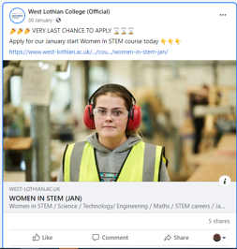
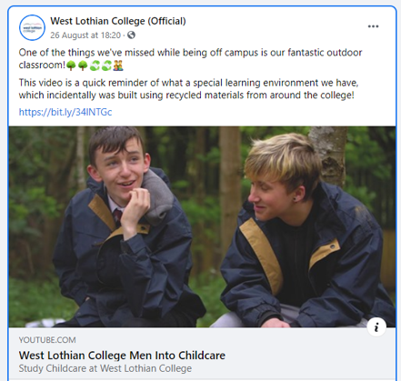
Examples of Strategies Used to overcome the challenge – Social Media
Men into Childcare
Women in STEM
©️Evolve Global Solutions Ltd

Slide 12
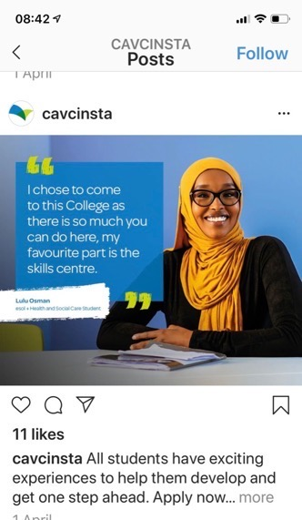
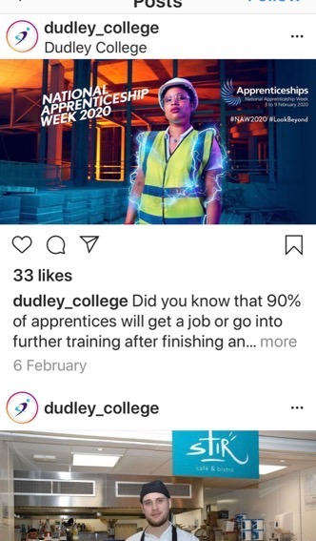


Slide 13
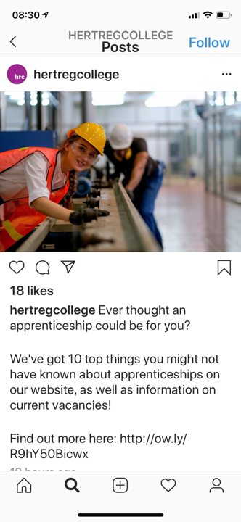

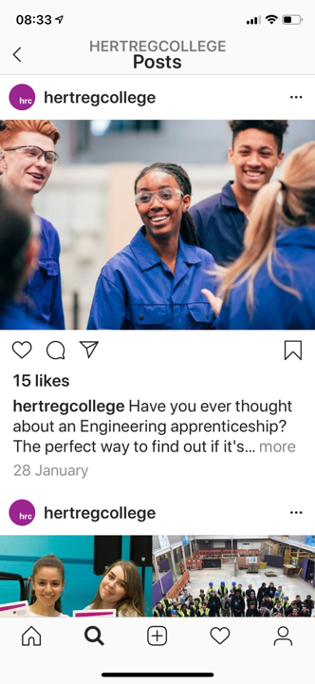

Slide 14
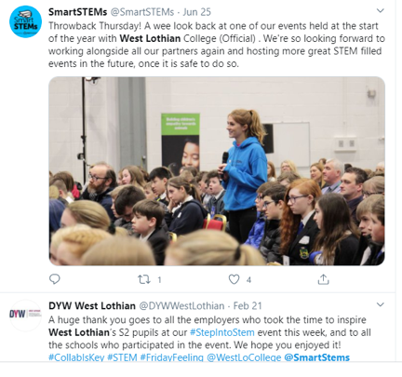
Examples of Strategies Used to overcome the challenge – Partnership / Collaboration
Working with primary and secondary schools – competition to promote STEM careers
  Lego competition, focus on STEM, but particular focus on girls participation
  STEM Olympics – challenges some posed by employers – cybersecurity – Sky TV
  SmartSTEMs – as before
©️Evolve Global Solutions Ltd

Slide 15

Impact experienced as a result of strategies implemented - Awards
SmartSTEMS and Men into Childcare – both won awards
PR – Raises reputation & public messaging also increasing pride internally
©️Evolve Global Solutions Ltd

Slide 16
Impact experienced as a result of strategies implemented
Challenging unconscious bias – training offered to all staff and uptake goal of 100%
Auditing college estate physical and social media to ensure balanced representation of male and female imagery, as well as other diversity balance – increased numbers of applicants to non-typical gendered courses
Gender action plan for each department – smart actions to promote rapid progress
Gender Action Plan – report to funding council and actions monitored – drives change
©️Evolve Global Solutions Ltd

Slide 17
Whole Organisation Approach
Staff with specialist training in how to support specific groups
Organisation values, messaging, visuals
Career advice and guidance – independent and gender neutral
Counselling and Health & Safety (e.g., health clinic)
Partnerships with specialist organisations
Tutorials (e.g., Individual Learning Plans, individualised targets)

Slide 18
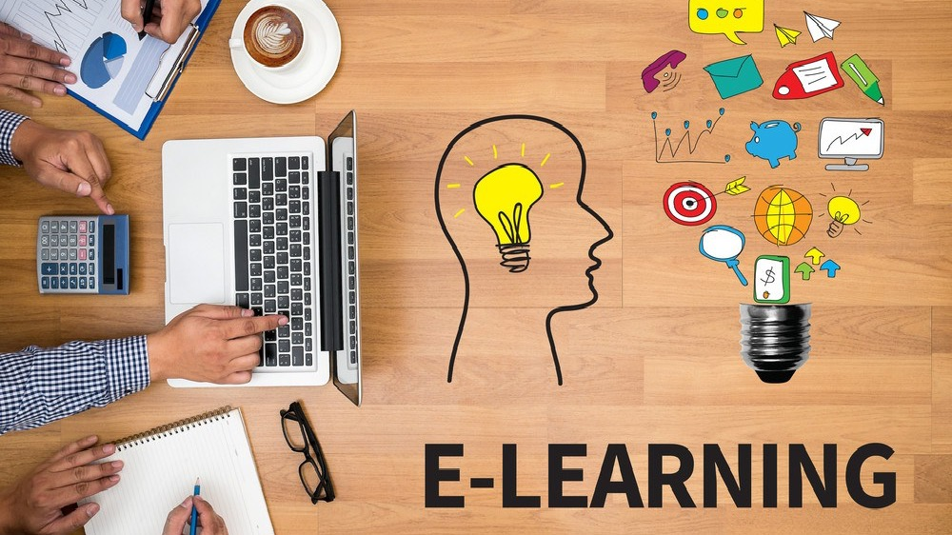
This Photo by Unknown Author is licensed under CC BY-SA-NC

Slide 19

Developing the ‘whole’ learner, managing change and transition, re-enforcing positive messages and behavioural change
©️Evolve Global Solutions Ltd

Slide 20
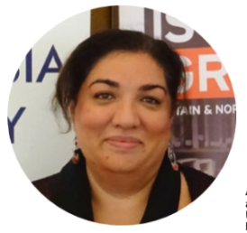
Age
Ability
Gender Identity
Religion
Intersectionality
Nationality
Ethnicity
©️Evolve Global Solutions Ltd

Slide 21
EDI – Equality, Diversity and Inclusion
Training aimed at helping staff and learners to be more aware, change attitudes and behaviour, and take responsibility - EDI, inclusive leadership, unconscious bias
Robust policy and processes to support
The requirement to comply - inspection / audit
Mentors, advocates and allyship
Data collection – what does the data tell us?
©️Evolve Global Solutions Ltd

Slide 22
Factoring in external forces
Media
Rules and expectations in society and at work
Family/community expectations
Peer pressure
The whole system must support for us to see change
©️Evolve Global Solutions Ltd

Slide 23


Thank You!
Evolve Global Solutions Ltd
Afshan Baksh, Skills Specialist
afshan@evolveglobal.co.uk
www.evolveglobal.co.uk

